Slide 1
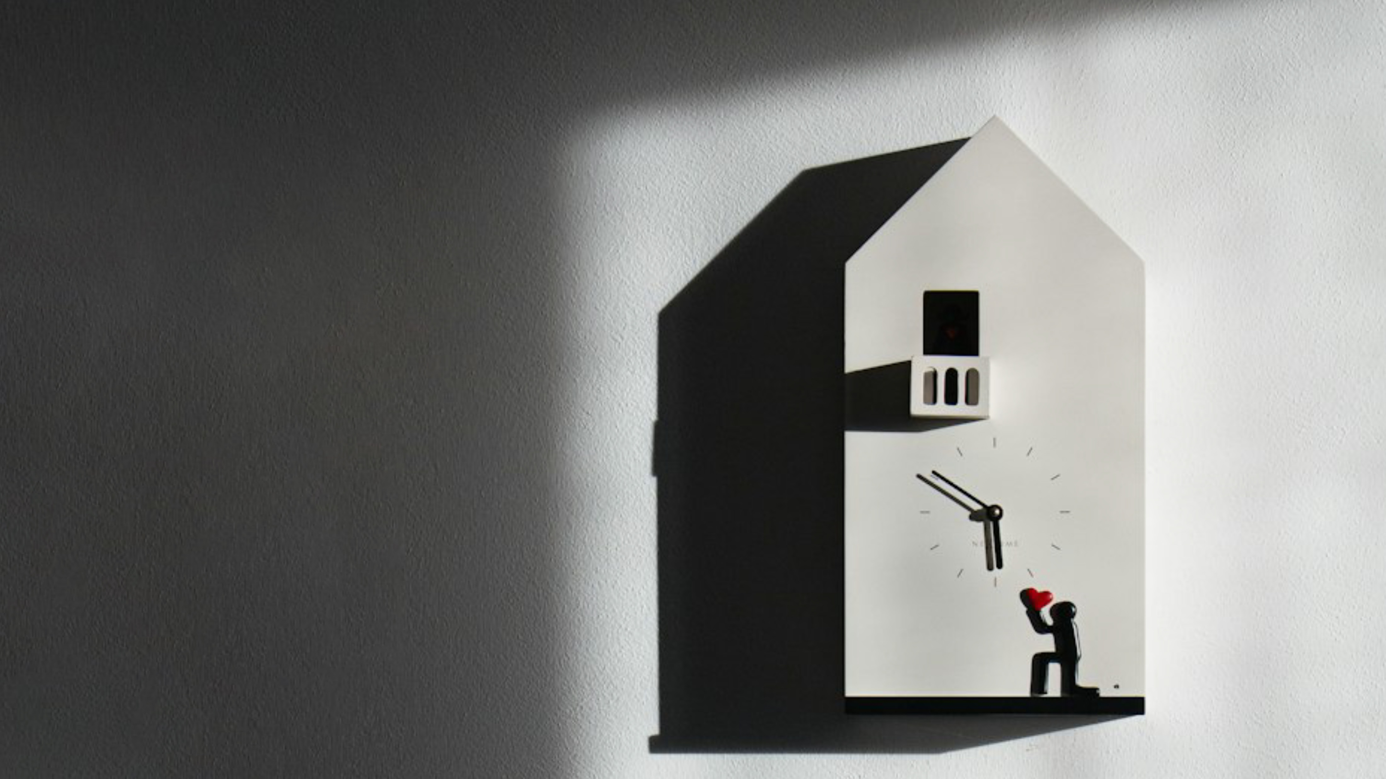
Housing
The baton falls
Premises
At the mercy of unknowns
Renovation
On departure
Infrastructure
Change leads to growth
Waiting time is long
Construction has fallen from the growth locomotive during zero interest rates to the biggest brake on the Finnish economy. A turn in construction is eagerly expected everywhere. Construction minuses will decrease towards the end of the year. However, the actual turn is not yet at hand. Recovery will also be exceptionally slow in the next few years. Production will remain a long way from what we were used to.
Economic outlook 2/2024

Slide 2
Editorial
Waiting time is long
Construction has fallen from the growth locomotive during zero interest rates to the biggest brake on the Finnish economy. Everyone is now waiting for a turn in construction. Households need new apartments. Investors would like to invest, banks to loan and constructors to build. The media and the general public would like to hear good news from the construction sector. Interest rates are falling on both sides of the Atlantic, and the bottom touch of the Finnish economy is behind us. Construction always reacts to the rest of the economy. Is the turn in construction at hand now?
Long minuses also decrease in construction. However, little is happening in the Finnish economy from the perspective of construction. Economic indicators are still mainly below zero. The wished-for better end of the year built is still a poor comfort for constructors waiting for the time after the deep crisis. Of course, projects are being prepared. But people are playing it safe now.
There are tools for recovering in the housing sale. Instead, the construction of new apartments still has many hindrances. Free-funded housing construction continues to be paralysed, and this year, state-subsidised production, which has been raised counter-cyclically, will be reduced by thousands of apartments, starting next year. There is no substitute for free-funded demand in this situation. It is not possible to change baton between supported and free-funded construction. Housing production will remain at a low level. The building of premises will only be speeded up properly as the international real estate market recovers and investors become interested in Finland again. In industrial investments, the main rule in recent years has been transition. There are fortunately still many projects. Constructors have little faith in receiving projects in Finland. There are preconditions for the recovery of renovation construction. However, funding outside growth regions remains challenging. It seems reasonable that infrastructure construction has seven better years ahead. Geopolitics and the energy transition shape the operating environment significantly. However, ambition and funding do not correspond to the Nordic strategic level.
In our forecast, construction will grow next year. In practice, growth is generated due to the weak comparison figures after the collapse. So we still have to wait for a proper turn.
The real problem is here: Finland will not be on a proper growth path in the future either. A slow-moving economy and high interest rates make the recovery of construction slow. The uncertain waiting period will continue in the next few years, and the volume of construction will remain unusual. Construction is at the core of the economy and well-being.
Finland now has to cope with less construction than usual. In order to boost economic growth from the present situation, it would be sufficient simply to get construction on its feet. Long-term growth cannot be achieved if construction is broken more permanently while waiting. The responses of the economic policy to this equation have so far been limited. A country that does not construct well is not doing well. Waiting time is getting too long. An empty site is expensive for everyone.
"Empty site
becomes expensive for everyone"
Jouni Vihmo
Chief Economist
jouni.vihmo@rt.fi
050 5201636
X: @jounivihmo
A country that is built well is a country that feels well.

Slide 3
Overview of topical construction themes No turn The bottom touch of the Finnish economy is at hand. However, little is happening in the economy from the perspective of construction. Construction production will fall throughout the year and employment will fall far into the next year. There are tools for recovery in the housing sale. The construction of new apartments still has many hindrances. In order to boost economic growth, it would be sufficient simply to get construction on its feet. The recovery of construction will be very slow in the next few years. The level of production will remain far from normal.
Economic situation
Brighter future
Production
Will decrease whole year
Housing market
Tools for recovery
Housing new construction
Many hindrances ahead
3
4.10.2024

Slide 4
Added value in construction
-7.8 %
Financial crisis
4.2%
-16.0 %
-7.0 %
4.0%

Slide 5
Zero growth and poor trust are not yet a turning point
Source: Statistics Finland, EK

Slide 6
Production of apartment blocks almost entirely state-subsidised Free-financed production is still in difficulty
Source: ARA, Statistics Finland

Slide 7
Poor development in premises Recovery will only accelerate as the international real estate market picks up and investors return to Finland
2024: -20 %
EK investment enquiry
(kesä 2024)
Source: Statistics Finland, KTI, EK

Slide 8
Repair is diving - the positive trend in infrastructure is depleted The 20th century of repairs exceptionally sticky - infrastructure construction declining for 3 consecutive years
Source: Statistics Finland

Slide 9
Conditions for the recovery of the housing market An upward trend in housing sales continues
Source: Bank of Finland, Financial Services (Bank Barometer August 2024)

Slide 10
Poor rest of the year for the housing market? Rapid fall in interest rates stimulates the housing market – the level of activity is exceptionally low so far
Source: Statistics Finland, Bank of Finland

Slide 11
The investor’s equation is still broken Decreasing costs and interest make room – oversupply and poor rent development still slowing down
Source: Statistics Finland, Bank of Finland

Slide 12
Lower housing prices make projects unprofitable Returning to higher prices takes several years
Source: Statistics Finland

Slide 13
Level of construction will remain unusual in the next few years Interest rates higher than before and the Finnish economy is not on a path that supports recovery
1975
Oil crisis
1983
Oil crisis
1990
The recession of the 1990s
2001
IT bubble
2008
Financial
crisis
2012
Debt
crisis
2020
Corona crisis and
War in Ukraine
Ø 41 Mm³
-10 %
-14 %
-23 %
-38 %
-26 %
-34 %
-60 %
Source: Statistics Finland, forecast RT (September 2024)
Notes:
Eri kriiseissä aloituskuutioiden pudotus keskimäärin 30 prosenttia ja vähintään 10 prosenttia

Slide 14
Overview of construction in 2024-2025 Recovery is exceptionally slow There is no prospect of a return to the standard level of production. Subsidised housing production will decrease with thousands of apartments as market-based production begins with a delay. It is not possible to change the baton between state-subsidised and market-based production. Housing production will be staying down. The growth of premises will only accelerate as the international real estate market picks up and investors are again interested in Finland. There are preconditions for recovery towards the end of the year. Infrastructure has the potential for more permanent growth led by geopolitics and the energy transition.
Housing
Subsidised production will halve
Premises
At the mercy of others
Renovation
On departure
Infrastructure
Change leads to growth
14
4.10.2024

Slide 15
2023
in total
38.2
BILLION €
Construction outlook 2024-25: growth from collapse – exceptionally poor outlook
6.1
BILLION €
9.1
BILLION €
15.7
BILLION €
7.2
BILLION €
Housing
2022: 5.5%
2023: -36.0%
2024: -26.0 %
2025: 15.0%
The baton falls
There are tools for recovering in the housing sale. New production remains weak. Government-subsidised production will decrease by thousands of apartments. There is no substitute for free-funded demand anywhere. No return to what we were used to.
Non-residential construction
2022: 1.4 %
2023: -2.0 %
2024: -3.0 %
2025: 2.0%
At the mercy of others
The view is poor. Recovery will accelerate
only when international markets
pick up and when the interest of foreign investors is again on Finland.
Renovation
2022: 3.4 %
2023: -7.0 %
2024: -4.0 %
2025: 1.0 %
On departure
The decrease has continued to be stronger than expected. The improvement in the economic background factors will advance the outlook already towards the end of the year. There will be slight growth next year.
Civil engineering
2022: -1.4 %
2023: -7.0 %
2024: -2.0 %
2025: 2.0 %
Change leads to growth
The decrease will continue this year.
Next year we will be able to grow for the first time in three years. Growth continues
driven by geopolitics and the energy transition.
+
+
+
Ø -5.0 % in 24–25
Ø 0.4 % in 24–25
Ø 0.0 % in 24–25
Ø 0.0 % in 24–25
= CONSTRUCTION IN TOTAL*: 2022e: +3.4 % 2023e: -16 % 2024e: -7 % 2025e: +4 %
*Fixed price added value
Source: Statistics Finland, RT forecast September 2024

Slide 16
Questions?
A country that is built well is a country that feels well.
Jouni Vihmo
Chief Economist
jouni.vihmo@rt.fi
+358 50 5201636
X: @jounivihmo

