Slide 1
Confederation of Finnish Construction Industries RT (CFCI)

Slide 2
Confederation of Finnish Construction Industries RT (CFCI)
Rakennusteollisuus RT (CFCI) represents Finnish construction companies in industrial policy, technical matters and labor market matters
The RT federation consists of the main federation and six industries: Building Construction, Infra Contractors, Construction Product Industries, Building Services, HPAC Branch and Surface Branch
RT is one of the largest member organizations of the Confederation of Finnish Industries (EK)
All major associations of companies operating in the building, construction and specialty industries are members of RT
RT has almost 3,000 member companies, which are employing around 60,000 people. The total turnover of the members is EUR 21 billion

Slide 3
Operation idea and targets
Operation idea:
To promote profitable and long-term business operations for its member companies
To ensure that the interests and importance of construction industry are strengthened both within Finland and the globalizing operating environment
Targets:
To promote co-operation within companies and associations in the construction branch
To strengthen trusteeship of construction industries and its influence both in Finland and in the field of international operational environment (globalization)

Slide 4
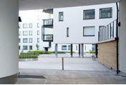
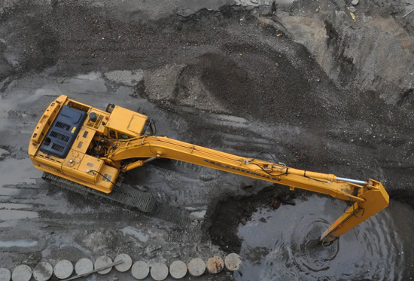
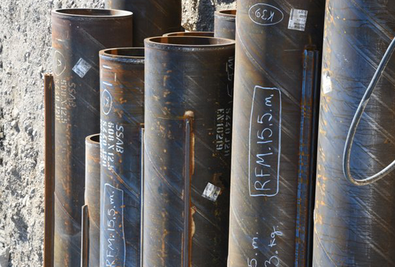
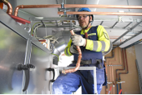
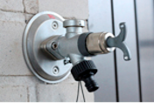
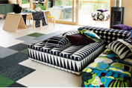
Confederation of Finnish Construction Industries RT (CFCI)
Finnish Association of Construction Product Industries
Building Services Industry and Trade
Federation of Surface Contractors
Building Construction
Infra Contractors
HPAC Contractors
Arkta, Bonava, Consti, Cramo, Fira, Hartela, Jatke, Kymppi Group, Lujatalo, NCC, Pallas Rakennus, Peab, Pohjola Rakennus, Ramirent, Skanska, SRV, Varte, YIT, Lehto Group etc.
Asfalttikallio,
Boskalis Terramare, Destia, E. Hartikainen, GRK, Havator, Kreate, MP Logistiikka, NRC Group Finland, Rudus, Sparal, Tallqvist, VRJ Group, YIT etc.
Betset, DEN Finland, Finnsementti, Kastelli-talot, Lujabetoni, Nordkalk, Parma, Paroc, Rudus, Saint-Gobain etc.
Are, Bravida, Caverion, Kemin Vesi-Piste, Keski-Suomen Ilmastointihuolto, KotiSun, Nuotek, Quattro Mikenti, TRP etc.
Allaway, Climecon, Danfoss, Halton, Onninen, Oras, Rettig Lämpö, Uponor etc.
Forbo, Heikkinen Yhtiöt, Icopal, Kährs, Katepal, KerabitPro, Oulun seudun maalaus, Maalausliike Mika Aaltonen etc.
RT's 3,000 member companies represent the industry comprehensively

Slide 5
Confederation of Finnish Construction Industries
Confederation of Finnish Industries (EK)
Rakennusteollisuus RT (CFCI)
Finnish Association of Construction Product Industries
Federation of Surface Contractors
Building Services Industry and Trade
Building Construction
Infra
Contractors
HPAC Contractors
327 member companies
(31.12.2022)
6 regional offices (9 district associations)
571 member companies (31.12.2022)
7 regional offices (9 district associations)
1 590 member companies (31.12.2022)
4 sections
105 member companies (31.12.2022)
293 member companies
(31.12.2022)
LVI-Numero Oy
51 member companies
(31.12.2022)
Notes:
Toimialojen jäsenmäärät 31.12.2022:
TRT: 571 jäsenyritystä
INFRA: 1590 jäsenyritystä
RTT: 105 jäsenyritystä
LVI-TU: 327 jäsenyritystä
Pinta: 293 jäsenyritystä
Talteka: 51 jäsenyritystä

Slide 6
Construction industry, total value in Finland (2022)
15,4 billion euros
Renovation
Residencial
8,9 B€
Other
premises
6,5 B€
Other
premises
10,1 B€
41,5
billion euros
Investments
5,4 B€
18,8 billion euros
New buildings
Residencial
8,7 B€
Maintenance
2,0 B€
7,4 billion euros
Infrastructure
Lähde: Tilastokeskus, Forecon Oy

Slide 7
Big industry –
big responsibility
1/5 50MRD. 60% 35%
Finns are employed by the built environment industries
Total value of the built environment industries
Total investments targeted to the build environment
Total emissions in Finland

Slide 8
RT’s strategy 2023–2028

Slide 9
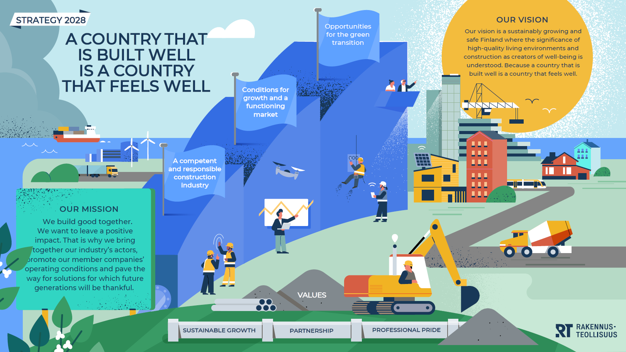
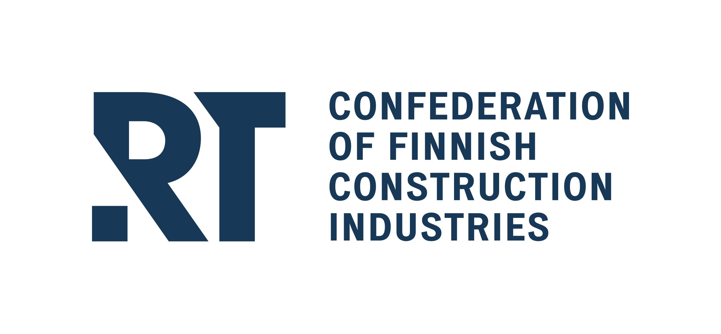

Slide 10
Our updated strategy responds to the unprecedented changes in the operating environment
Geopolitical challenges
War in Ukraine, global tensions, trade policy decisions and sanctions
Political and social uncertainty
Political short-termism, increased regional, attitudinal, social and economic polarisation
Economic uncertainty
Threat of recession, rising interest rates, rise of costs due to raw material, energy and sustainable development requirements, growing role of foreign investors
Changing labour market
Growing labour shortage, new competence needs and a more diverse working life
Investing in the future
Repair debt of built environment and infrastructure, public sector’s deteriorating investment capacity, new financing models and investment opportunities enabled by the private sector and private capital
Technological development
Material innovations, increased productivity enabled by technology and new business models
Green transition
Climate and biodiversity targets, energy efficiency, low-carbon and circular economy requirements, adaptation to climate change
Responsibility
Corporate responsibility and environmental legislation, ESG and reporting obligations, safety and health requirements for construction, equality and human rights issues
Increasing regulation
Political pressure to increase regulation if self-regulation in the industry is not proactive, increasing significance of EU-level sustainable development and financial regulation

Slide 11
RT focuses on three themes
1
2
3
A competent and responsible construction industry
Conditions for growth and a functioning market
Opportunities for the green transition
The availability of labour is a major challenge in the industry, and we strive to find solutions for it. We ensure a competitive and fair labour market and a safe and healthy working life. The future of the industry is built by healthy and diverse work communities and responsible operations that extend to all activities and are examined from all perspectives. The objective is to create a more responsible and attractive construction industry.
Construction creates growth and enables the sustainable renewal and well-being of society. We promote well-functioning markets and companies’ opportunities to build profitably and meet customers’ needs. We propose solutions to societal issues and influence the long-term development, objectives and steering of the built environment. At the same time, we bring together actors in the industry and support customer-oriented development of productivity and quality to ensure the success of the entire value chain.
The built environment offers an opportunity to significantly reduce environmental impacts, as it accounts for a significant share of emissions and natural resource consumption. We commit to Finland’s climate targets. We accelerate the emergence of a green transition market through effective regulation, by removing barriers and by ensuring adequate investments. We promote material and technology neutrality, innovations and new business models as well as increasing the competence level throughout the value chain.

Slide 12
Strategic themes
1
2
3
A competent and responsible construction industry
Conditions for growth and a functioning market
Opportunities for the green transition
1.1. A sufficient supply of competent and diverse labour
2.1. Long-term development of the built environment and sufficient investments
3.1. Ecologically sustainable construction and energy-wise solutions
1.2. A well-functioning labour market and a safe working life
2.2. Functional regulation and a fair competitive environment
3.2. Accelerating the green transition market and its functionality
1.3. Understanding responsibility throughout the value chain
2.3. Cooperation to improve productivity and quality
3.3. Promoting green transition innovations and business models

Slide 13
RT’s strategy 2023–2028
OUR VISION
Our vision is a sustainably growing and safe Finland where the significance of high-quality living environments and construction as creators of well-being is understood. Because a country that is built well is a country that feels well.
1
2
3
OUR STRATEGIC THEMES
A competent and responsible construction industry
Conditions for growth and a functioning market
Opportunities for the green transition
1.1. A sufficient supply of competent and diverse labour
2.1. Long-term development of the built environment and sufficient investments
3.1. Ecologically sustainable construction and energy-wise solutions
1.2. A well-functioning labour market and a safe working life
2.2. Functional regulation and a fair competitive environment
3.2. Accelerating the green transition market and its functionality
1.3. Understanding responsibility throughout the value chain
2.3. Cooperation to improve productivity and quality
3.3. Promoting green transition innovations and business models
OUR VALUES
SUSTAINABLE GROWTH
PARTNERSHIP
PROFESSIONAL PRIDE
We build good together. We want to leave a positive impact. That is why we bring together our industry’s actors, promote our member companies’ operating conditions and pave the way for solutions for which future generations will be thankful.
OUR MISSION

Slide 14
Top 10 goals for 2024 and beyond
A competent and responsible construction industry
Conditions for growth and a functioning market
Opportunities for
the green transition
1
Diversity, adequacy and excellence of the workforce
Management of occupational health, well-being and safety
Responsibility programme for the construction industry
4
Ensuring sufficient volume in the construction sector
Influencing the Act on the Use of Land and Water Areas and the revision of the Construction Act
Renewal of the General Conditions for Building Contracts (YSE) and the General Procurement and Delivery Terms for Construction Products (RYHT)
Measuring construction productivity
8
Implementation of the Energy Performance of Buildings Directive (EPBD)
Low-carbon construction
5
2
9
6
3
7
Influence and advocacy
Implementation and cyclical situation of the relevant Government Programme entries
10

Slide 16
More information:
firstname.lastname@rakennusteollisuus.fi, tel. 000 000 0000

